Slide 1
Refining the Approach to Process Flowsheet Development and Maturation at Hanford
Laura Cree*, Todd Wagnon*, Stuart Arm**
*Washington River Protection Solutions
**Pacific Northwest National Laboratories
March 11, 2020

Slide 2
Introduction to Process Flowsheets
Process Flowsheets consist of three main aspects:
Flow diagrams
2) Mass and energy balances
Laws of conservation of mass and energy
3) Process control strategies
How is the process controlled?
Input 1a
Process 1
Interface 1/2
Process 2
Output 2
Input 1b

Slide 3
Process Flowsheets at Hanford
Notes:
Four prime contractors, two DOE offices, multiple subcontractors
Integrating old with new with still in design

Slide 4
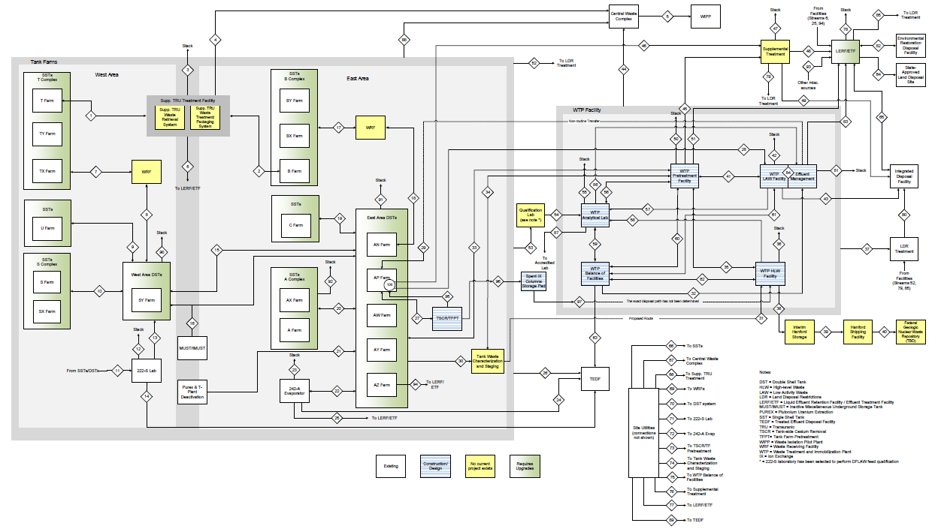
Evolution of the River Protection Project Integrated Flowsheet
58 inter-facility process streams, 21 crossing contractual boundaries
Continuous improvement
Focus on interfaces
Notes:
LEAN Management – 7 RIEs, one project, 2 JDIs
Independent review by SRR – 11 opportunities for improvement
Updates: focus on interfaces, new information, new process model, improvements to the process

Slide 5
Case Study #1 Strontium-90 Concentration Limits
Differing technical basis caused mismatch in assumptions
Multiple contractors, DOE offices involved
Extended institutional controls
Notes:
IDF WAC: 2.3 Ci/m3
WTP contract: 20 Ci/m3

Slide 6
Flowsheet Maturation
Identify and close gaps in technical basis
Create flowsheet maturation plans
Laboratory work and technical studies

Slide 7
Case Study #2 Corrosion Control Across an Interface
Technical basis for corrosion controls too narrow
Developed testing program to expand the technical basis
New, more robust chemistry controls

Slide 8
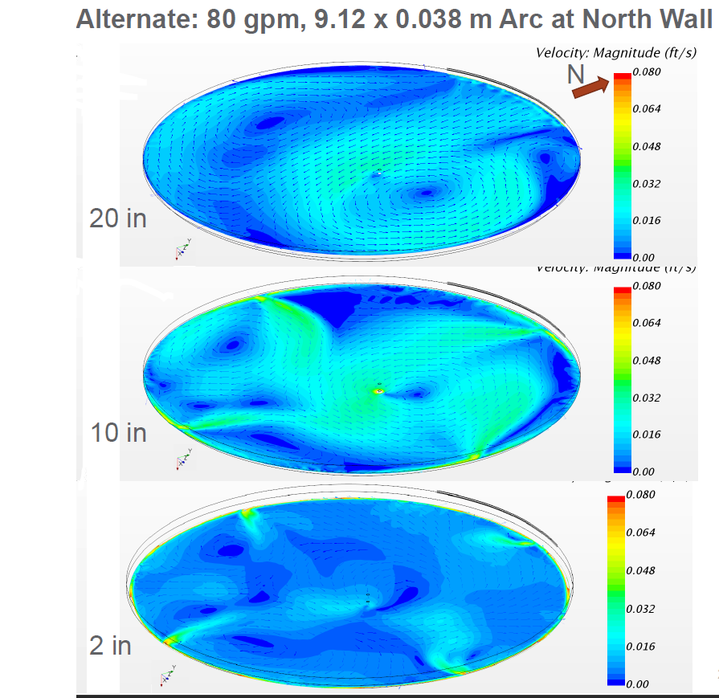
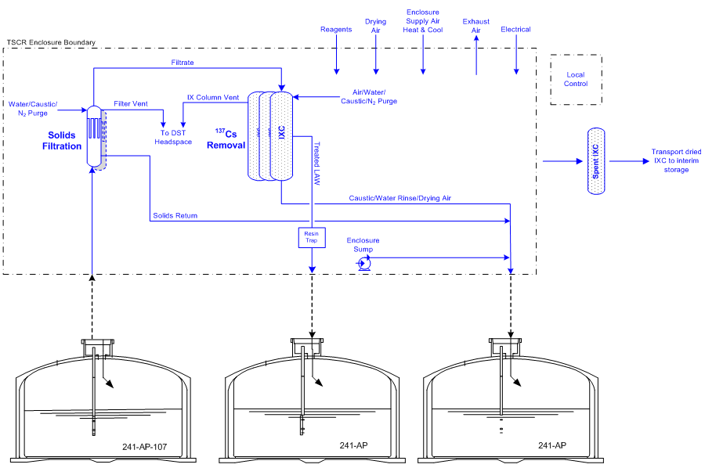
Computer Simulations as Process Flowsheet Tools
Simulations and models are powerful tools
Each model has its own benefits and limitations
Subject matter experts, designers and operators have different perspectives

Slide 9
Case Study #3 Repurposing a Double-Shell Tank
Brand new process
Questions about mixing behavior and corrosion chemistry
Fluid mechanical modeling
Laboratory testing

Slide 10
Integration with Project and Operations Teams
Process flowsheets can tell us how a process works, but not whether it will work in the field
Flowsheets need to be implementable
Early integration with designers and operators

Slide 11
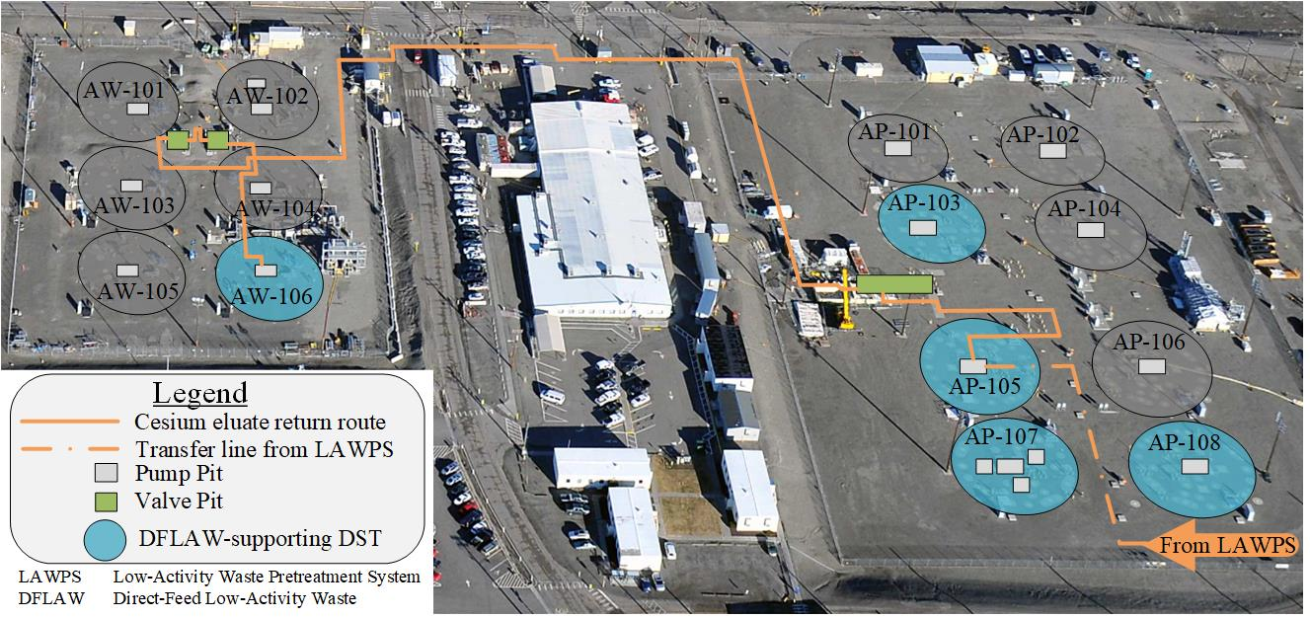
Case Study #4 Selection of DST to Support DFLAW
Unnecessarily complicated transfer path

Slide 12
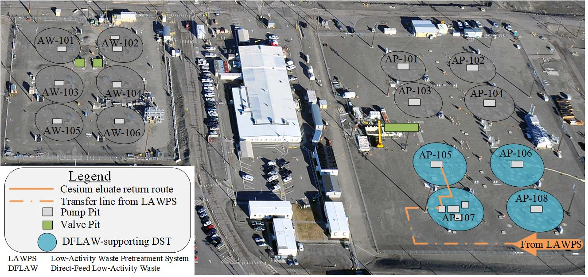
Case Study #4 Selection of DST to Support DFLAW
Feasible transfer path will not disrupt operations

Slide 13
Future of the RPP Integrated Flowsheet
Continue to close gaps
Incorporate lessons learned
Examine proposed updates
Continue integration and open communication
We have a mature, robust flowsheet and an
integrated, nimble program team.

Slide 14
One Hanford

